Slide 1


Introducing
OpenShot Library
Video Editing Framework
By Jonathan Thomas

Slide 2

OpenShot Video Editor
OpenShot is a free, open-source, non-linear video editor for Linux. It is designed to be simple, powerful, and flexible.
It can create and edit videos
It can edit and mix audio
It can export videos in many formats
With each release of OpenShot, we also produce a short “release video”...

Slide 3
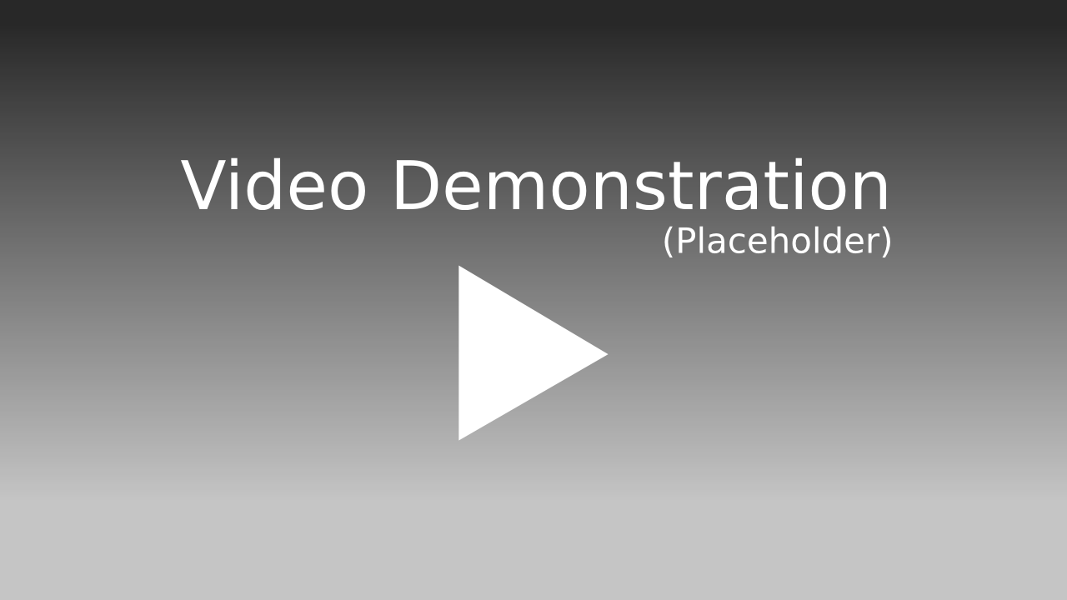
Release Video
Click Here to Watch on Vimeo

Slide 4

The Future of OpenShot
New Video Editing Framework
  More Stable
  Improved Animation Features
  Better Performance
  Frame Accuracy
Cross-Platform
HTML Canvas
OpenGL Video Preview

Slide 5
OpenShot Library
What does it do?
  libopenshot is a library, which can read, edit, and write videos, images, and audio files.
How should it work?
  Super Simple API (C++ & Python)
  Ridiculously Stable (No Crashing)
  Crazy Fast (Use All CPUs)
  Cross-Platform (Linux, Mac, Windows)

Slide 6

Super Simple API
Why should it be difficult?
  Video & audio libraries are famously difficult and complicated to use.
Example Code:
  r = openshot.Reader(“Video.webm”)
  r.GetFrame(300).Save(“Frame.png”)
  r.GetFrame(400).Display()
  r.Close()

Slide 7
Abuse Your CPUs!
How fast is Crazy Fast?
  Using pools of worker threads, each frame is processed in parallel with many other frames.
Will all your CPU cores be used?
  Absolutely
Will your CPU hate you?
  Probably

Slide 8
Basic Features
Save Thumbnails
Add Text & Overlays
Trim & Resize Videos
Transcode Videos
Access Video Metadata
  r = Reader(“A.webm”)
  r.info
    height, width, fps, ratio, sample rate, channels, bit rates, timebases, codecs...

Slide 9
Advanced Features
Animation Curves
Time Re-mapping
Sub-pixel Image Processing
Chroma Key
Color Animation
Waveform Animation
Compositing & Layers

Slide 10
Animation Curves
What is animation?
  The changing of values over time. Values such as Position, Size, Rotation, Alpha, Volume, Color, or even Time Itself.
How can curves help?
  A curve is nothing more than a series of points (X,Y). Now imagine the Y-axis as the value (Volume), and the X-axis as time (frame #).

Slide 11
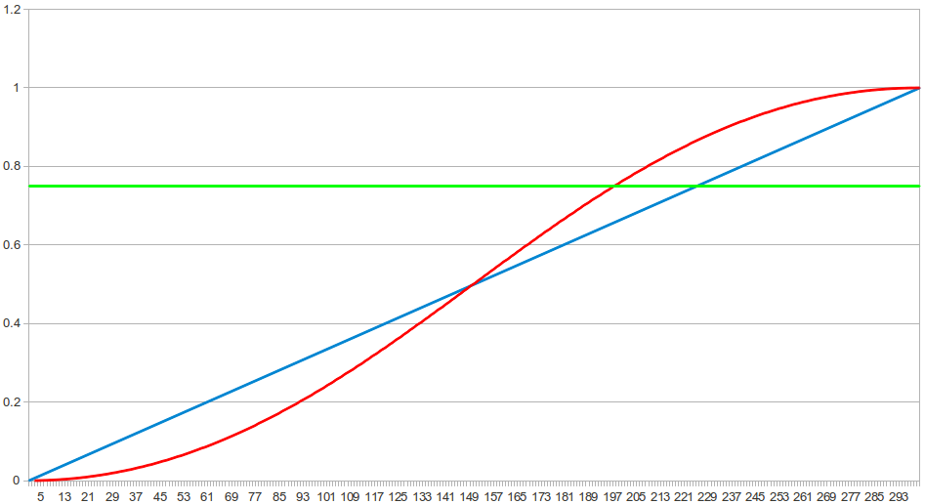
Animation Curves
Volume Over Time
Constant Curve
Linear Curve
Bezier Curve

Slide 12
Curve API
Are curves easy to use?
  I hope so, because they control everything in the OpenShot Library.
Example Code:
  k = openshot.Keyframe()
  k.AddPoint(1,300)
  k.AddPoint(300,1)
  k.GetValue(150)

Slide 13
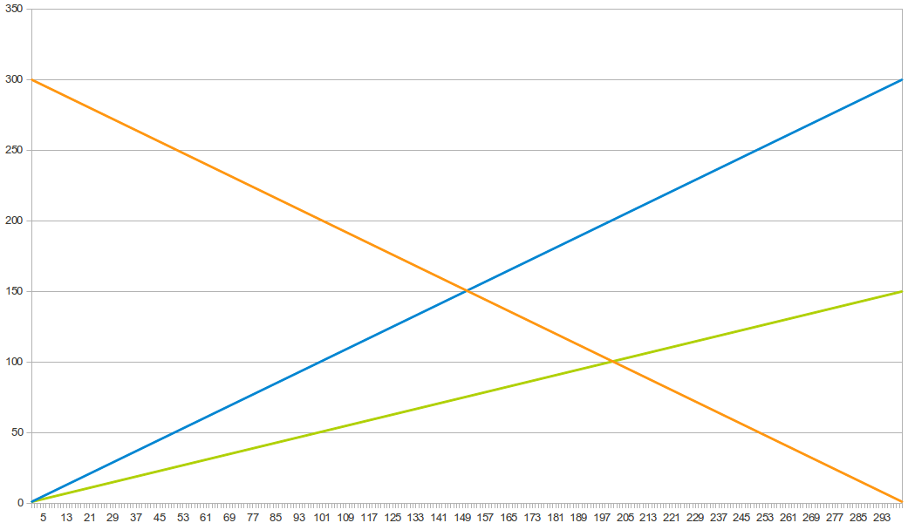
Time Re-mapping
Direction & Speed Curves
Reverse (1X)
Forward (Slow)
Forward (1X)

Slide 14
Time Re-mapping
Click Here to Watch on Vimeo

Slide 15
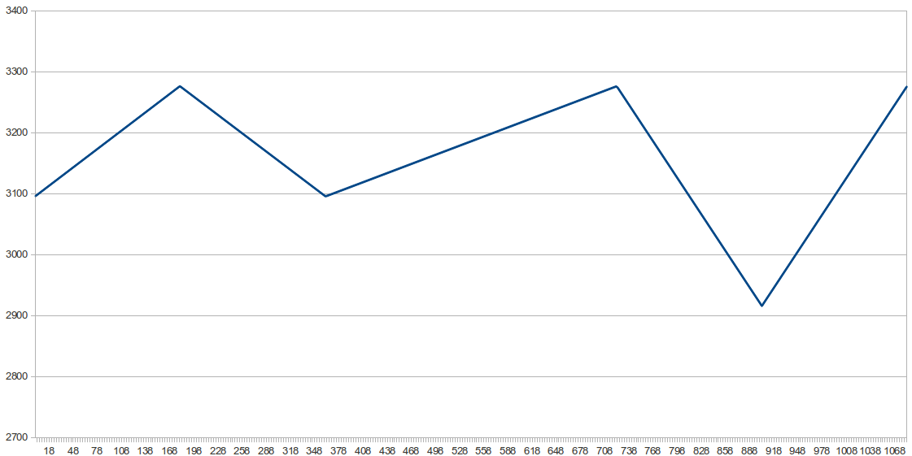
Time Re-mapping
Examine the Curve
Forward (1X)
Forward (Slow)
Reverse (1X)
Reverse (2X)
Forward (2X)

Slide 16
Sub-pixel Precision
Often it is necessary to move pixels less than 1 pixel. Fractions of pixel.
While that might be impossible, it is possible to create the illusion of sub-pixel precision.
Using image distort algorithms, sub-pixel precision is possible.

Slide 17
Color Animation
All colors are represented by 3 curves: Red, Blue, and Green.
Example Code:
  blue.AddPoint(1, 65000)
  blue.AddPoint(300, 0)
  red.AddPoint(1, 0)
  red.AddPoint(300, 65000)

Slide 18
Wavform Animation
Audio data is already a curve... just begging to be plotted and visualized.
We make it easy & fun :
  r = Reader(“A.webm”)
  r.Waveform(true)
  r.wave_color.red = ...
  r.wave_color.blue = ...

Slide 19
Chroma Key
Replace a color with transparency.
Set a threshold, to also match similar colors.
Use multiple chroma key filters to match more than 1 color.
The transparent pixels will reveal the next layer of video on your timeline.

Slide 20
Compositing & Layers
What is compositing?
  The combining or mixing of two or more images.
Is it easy?
  t = Timeline(1280, 720,...);
  t.AddClip(c1)
  t.AddClip(c2)
  t.AddClip(c3)

Slide 21
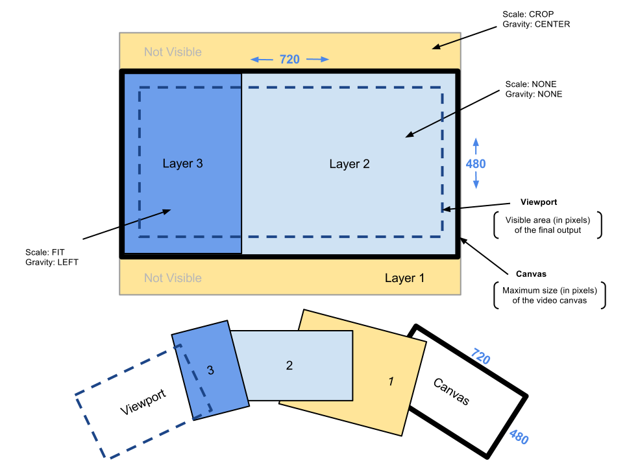
Compositing & Layers

Slide 22

Summary
Simple, Powerful, & Free
Fast & Multi-Core Aware
Supports Python & C++
Cross-Platform
Open-Source (GPLv3)
Let's See It In Action!

Slide 23
OpenShot Library Preview
Click Here to Watch on Vimeo

Slide 24
Questions?
www.openshot.org
By Jonathan Thomas

